Slide 1
AWS – X-Ray
By
Keshav Kummari

Slide 2
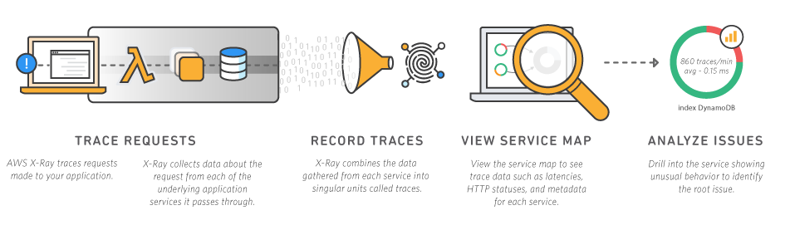
AWS X-Ray
AWS X-Ray makes it easy for developers to analyze the behavior of their distributed applications by providing request tracing, exception collection, and profiling capabilities.

Slide 3
AWS X-Ray traces requests as they move through your applications.
It collects data and makes it available to view, filter, and sort.
You can then use the data to gain insights and identify potential optimizations to make inside your application.
X-Ray concepts:
a. Segments - Data about the work done by your application(Can include data on: the request, the response, subsegments, and issues)
b. Subsegments - A more granular view of data inside of segments
c. Service Graph - A JSON document that contains information about how your application's services and resources interact(this can create a visualized service map)
d. Traces - Trace ID's track requests as they go through your applications:
a. The first X-Ray supported service to interact with a request adds an HTTPS trace ID header
b. The trace ID header propagates downstream to track the request as it moves through the system

Slide 4
e. Sampling - X-Ray applies an alogorithm to sample request data but you can configure the frequncy of sampling(e.g. to reduce it on high-volume or lower-volume requests)
f. Tracing Header - Examples : X-Amzn-Trace-id: Root=1-.5759e988;Sampled=1
g. Filter Expressions - used in the X-Ray console to search through your traces by different characteristics(e.g. Specific trace ids, partial URL paths, annotations)
h. Annotations and Metadata - Additional way to store searchable annotations and non-searchable metadata data about traces.
i. Errors, Faults, and Exceptions - X-Ray tracks application errors and categorizes them as:
a. Error - Client errors(400 series errors)
b. Fault - Server faults(500 series errors)
c. Throttle - Throttling errors(429 too many requests)

Slide 5
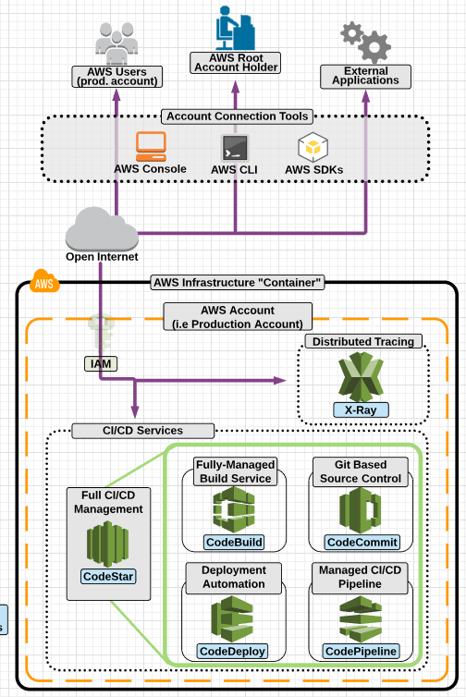
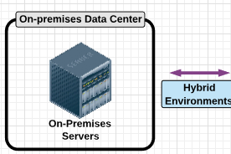

Slide 6
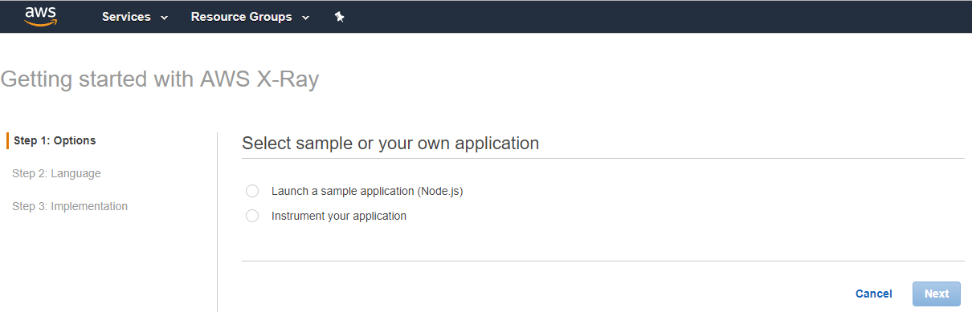
Step by Step X-Ray Service Practical Steps

Slide 7
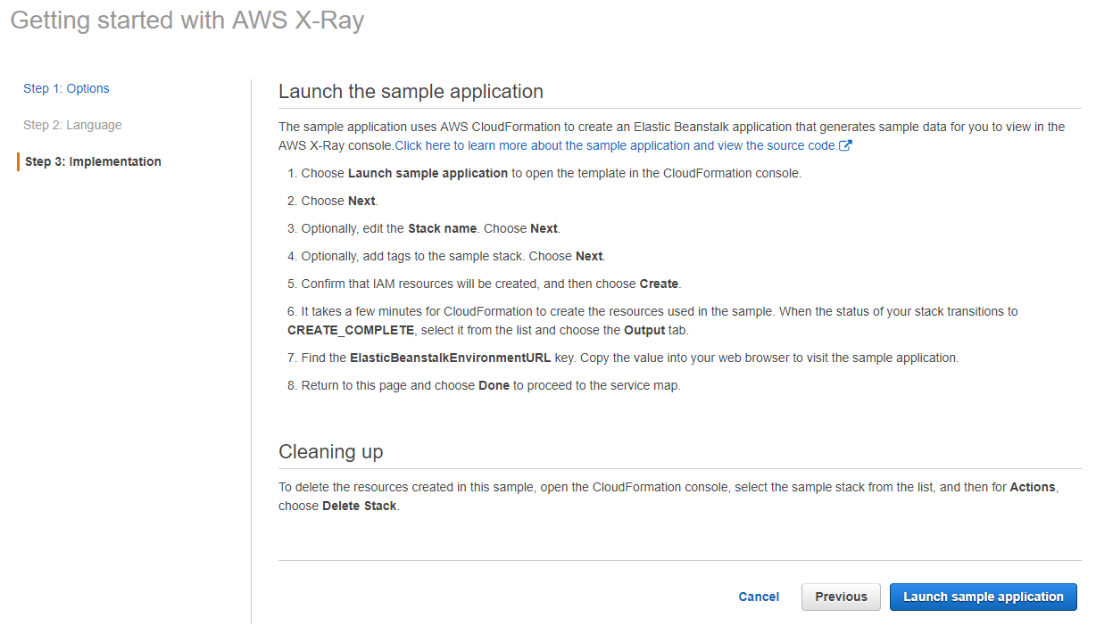
Click on “Launch Sample Application”

Slide 8
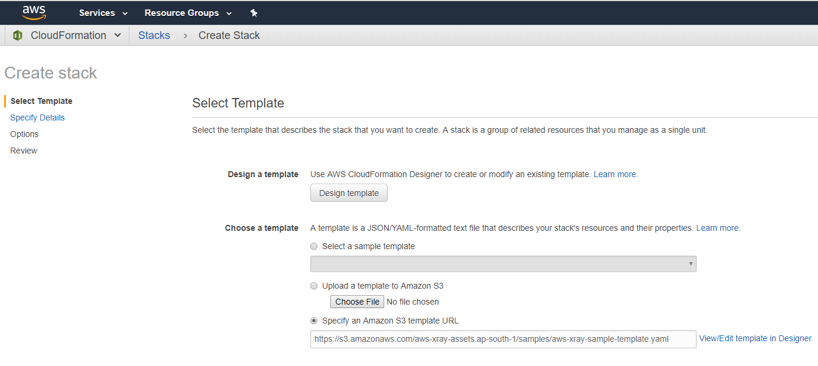
Click on “Next”

Slide 9
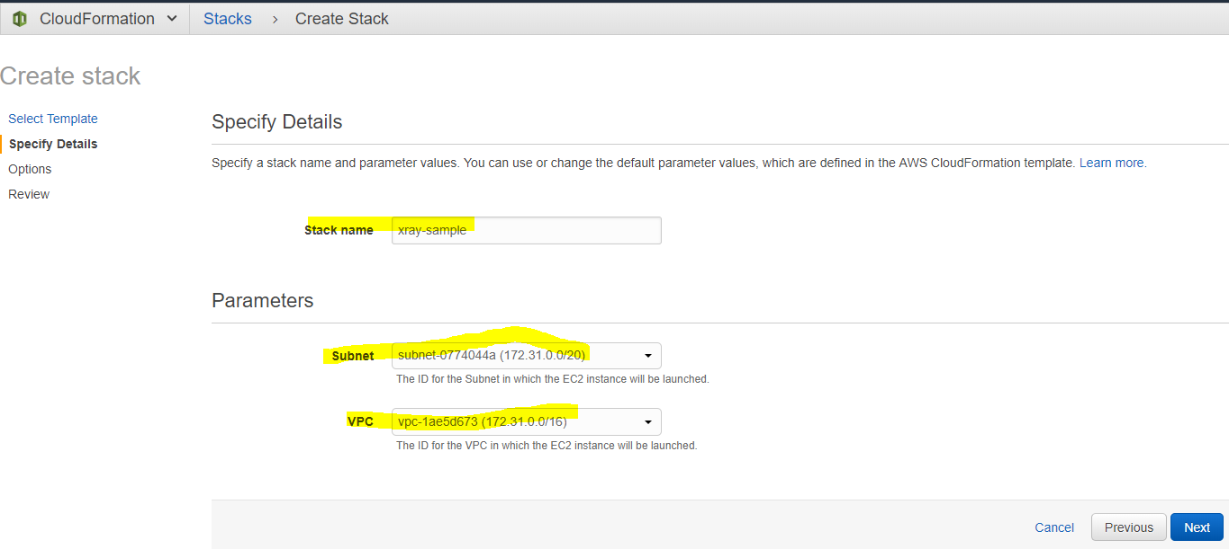
Click on “Next”

Slide 10
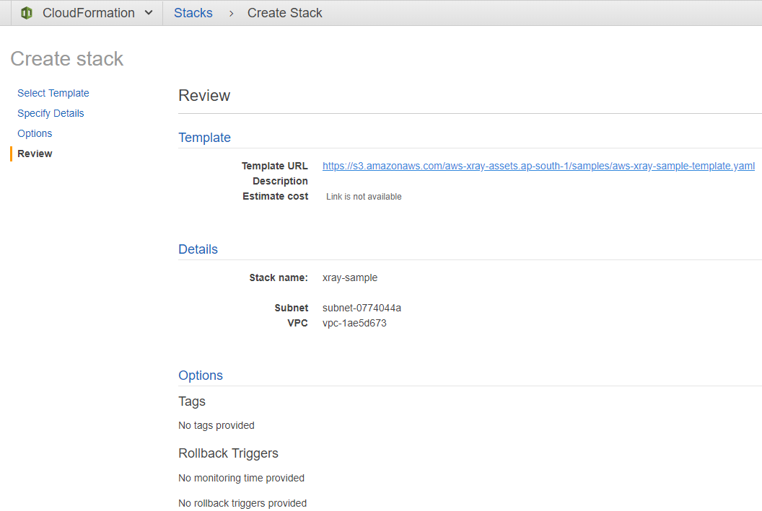
Review

Slide 11
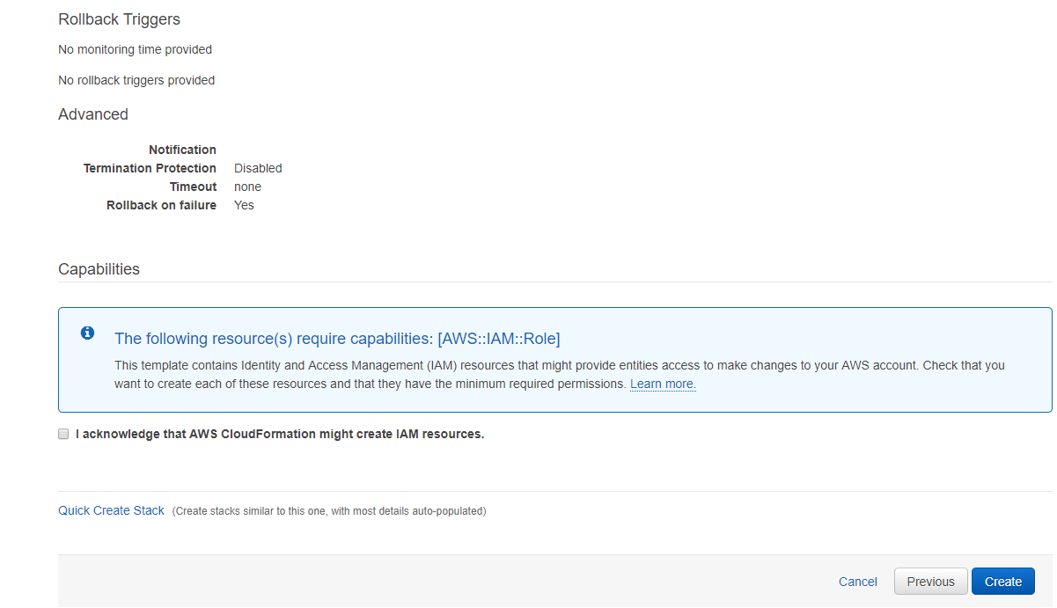
Click on “Create”

Slide 12
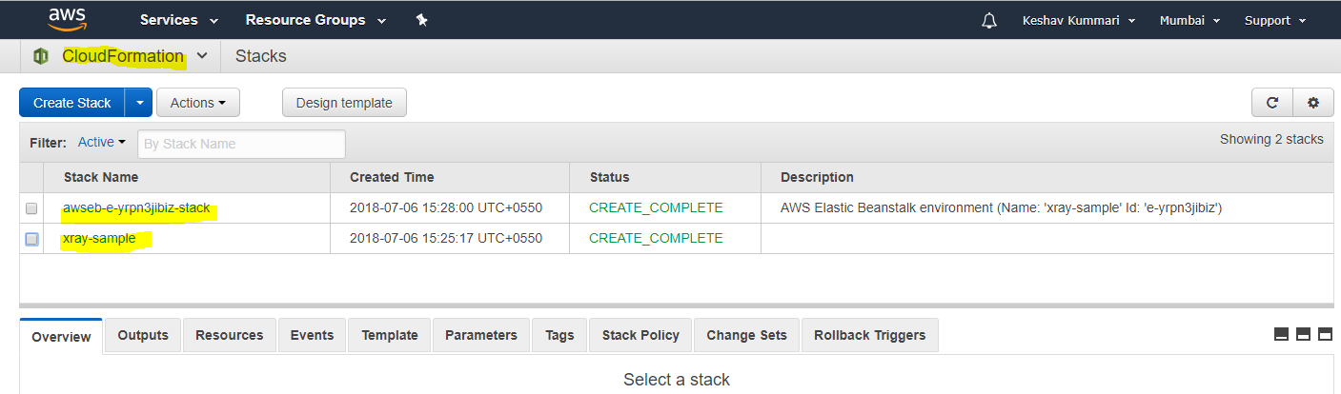
It has created two cloudFormation stacks

Slide 13
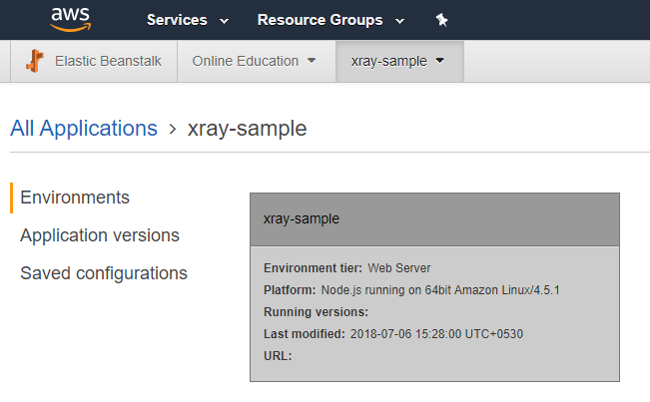
Go to >> Elastic Beanstalk and check Xray Sample Application is created

Slide 14
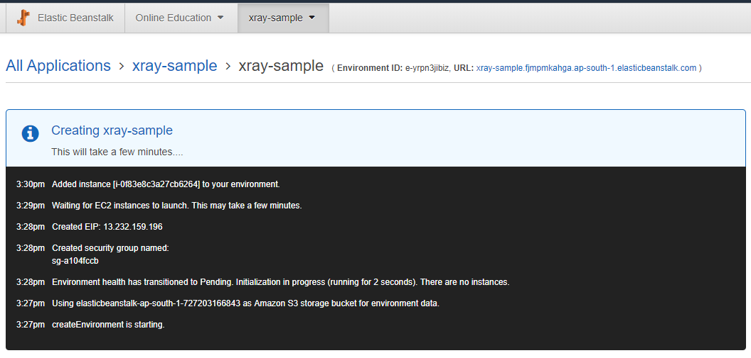
Click on “URL: xray-sample.fjmpmkahga.ap-south-1.elasticbeanstalk.com“

Slide 15
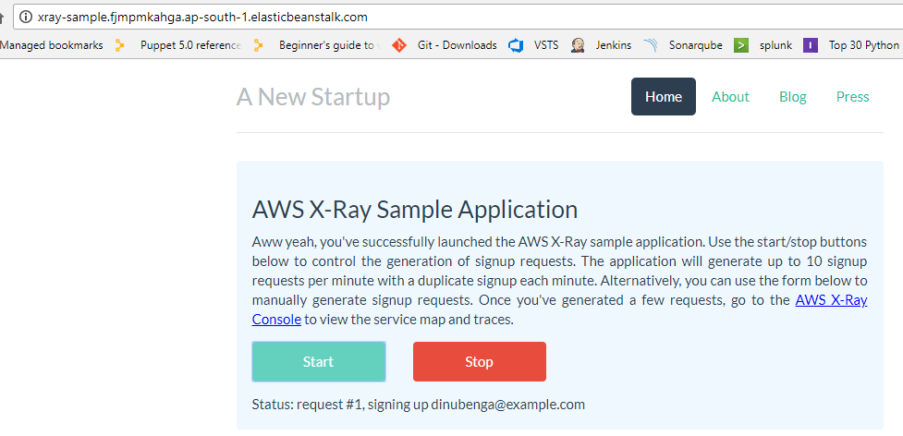
Click on “Start” button

Slide 16
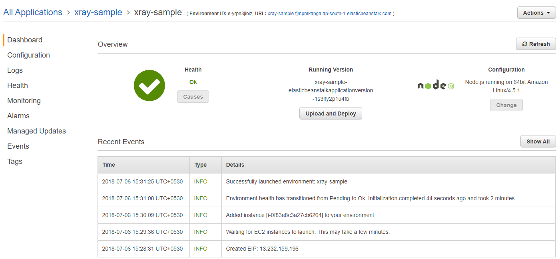
“nodejs“ application has been deployed

Slide 17
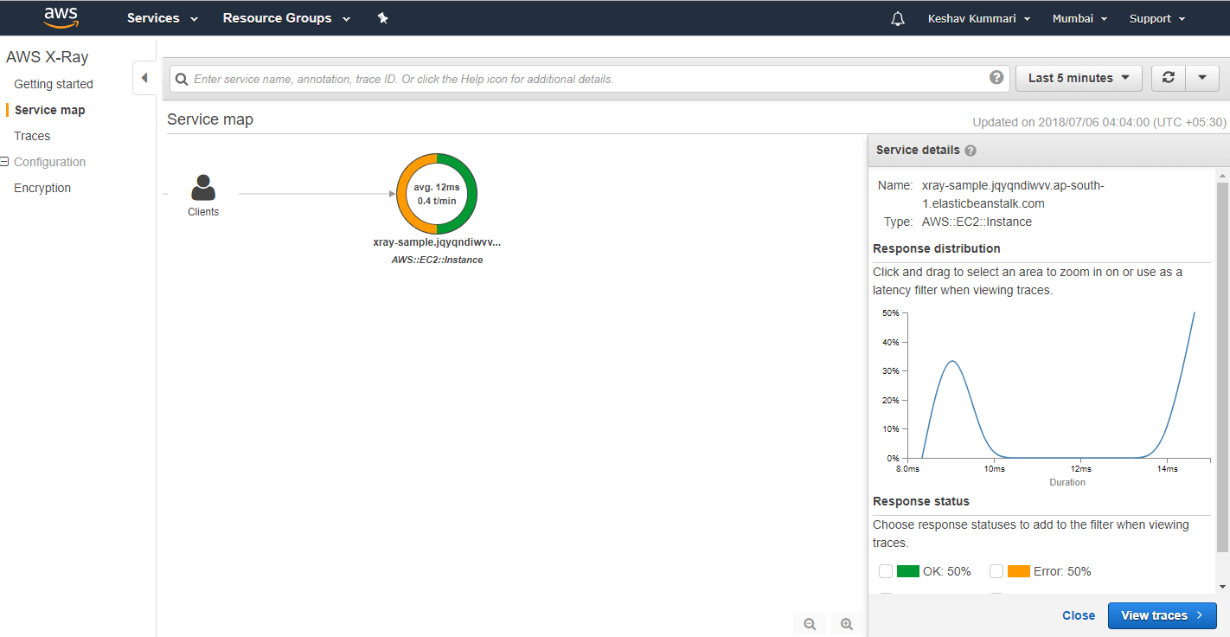
Check the Service Map

Slide 18
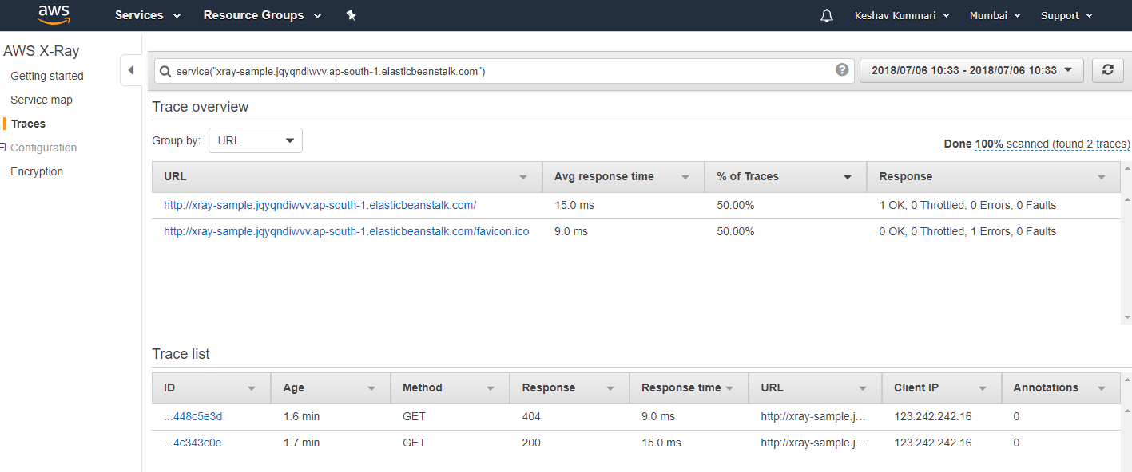
Click on “Traces” and cross check the trace info

Slide 19
Thank you so much

